Slide 1


Sri Venkateshwara College of Engineering DEPARTMENT OF COMPUTER SCIENCE AND ENGINEERING
Project Phase-I
On
“LOW LIGHT IMAGE ENHANCEMENT USING DEEP LEARNING”
PRESENTED BY
CHARISH PATEL M N 1VE18CS041
CHUNITH GOWDA G S 1VE18CS043
RASHMI S 1VE18CS134
SHIRISHA K S 1VE18CS146
Under the guidance of
Mr. Balaji K
Assistant Professor Dept of CSE, SVCE

Slide 2
INTRODUCTION
Low Light Image Enhancement Using Deep Learning
Low contrast, poor visibility, and noise characterizes images captured in low-light circumstances. These limitations provide a difficulty to both human vision, which favors high-visibility images, and many intelligent systems that rely on computer vision algorithms, such as all-day autonomous driving and biometric recognition. Image enhancement is basically improving the interpretability or perception of information in images for human viewers and providing better input for other automated image processing techniques. The principal objective of image enhancement is to modify attributes of an image to make it more suitable for a given task and a specific observer. In this project we present a method for enhancement of such images which can be done using Convolutional Neural Networks (CNN).

Slide 3
EXISTING SYSTEM AND ITS DISADVANTAGES
Low Light Image Enhancement Using Deep Learning
Sl No | EXISTING SYSTEM | DISADVANTAGES
1 | SRIE (Super Resolution Image Enhancement). | Limited Super-Resolution. High Time Consumption. Bleaching.
2 | Retinex. | Graying out. Poorly with unnatural images. Washout Appearance.
3 | Enlighten GAN | Realistic but not Real. Difficult for training and huge computation. Chance or creating Fake patterns.

Slide 4
PROPOSED SYSTEM
Low Light Image Enhancement Using Deep Learning
The proposed system has CNN of seven convolutional layers
Each layer consists of 32 convolutional kernels of size 3×3 followed by the ReLU activation function.
The framework is implemented with PyTorch.
The filter weights of each layer are initialized with standard zero mean and 0.02 standard deviation Gaussian function.
ADAM optimizer with default parameters is used with a fixed learning rate of 0.0001 for network optimization.
Down-sampling and batch normalization layers that break the relations of neighboring pixels are discarded.
The last convolutional layer is followed by the Tanh activation function.

Slide 5
OBJECTIVES OF PROJECT
Low Light Image Enhancement Using Deep Learning
The objectives of the project are
To illuminate the images captured in low light conditions.
Minimize the image quality degradation after enhancement.
Coping up with diverse lighting conditions such as non uniform and poor lighting conditions.
To brighten up the image while preserving the inherent color and details.

Slide 6
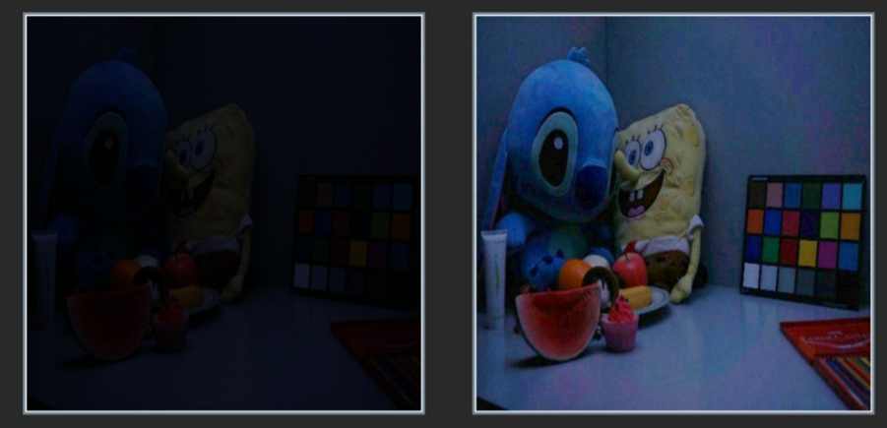
Low Light Image Enhancement Using Deep Learning
Before
After

Slide 7
METHODOLOGY
Low Light Image Enhancement Using Deep Learning
The proposed system makes use of CNN. By CNN we can manipulate the pixels of the low light image to change their attributes and thus enhancing the image.
The important components of the network are as follows.
Convolution layer
The proposed system has CNN of seven convolutional layers. The framework is implemented with PyTorch. Each layer consists of 32 convolution kernels with size 3x3, and the weights of these kernels do not change during the convolution process. With the convolution operation, it extracts the different features of the input images at different convolution levels. The output of the first CNN layer roughly depicts the location of low-level features (edges and curves) in the original image. On this basis, another convolution operation is carried out, and the output will be the activation map representing higher-level features.
Dept of CSE, SVCE

Slide 8
METHODOLOGY
Low Light Image Enhancement Using Deep Learning
Activation layer
The activation layer is vital in a deep CNN because the nonlinearity of the activation layer introduces nonlinear characteristics to a system which has just undergone linear computation. We have adopted a rectified linear unit (ReLU) for its advancement in improving the training speed without obvious changes in accuracy.
Max-pooling operation
The pooling operation is helpful to reduce the number of parameters, decreasing the training cost by a meaningful extent. The pooling operation can also cut down the possibility of overfitting, helpful to suppress noise. For the model, we have set the kernel size to 2 for each max-pooling operation.
Upsampling layer
Max Pooling layer is followed by upsampling layer, that will double the dimensions of input.
Dept of CSE, SVCE

Slide 9
INPUT AND EXPECTED OUTPUT OF THE PROJECT
Low Light Image Enhancement Using Deep Learning
INPUT:
The proposed method uses a low-light image as input and produces high-order curves as output. It can work in nonuniform and low lighting conditions as well. The images of the format .jpg and .png are supported.
OUTPUT:
An highly enhanced restored image of the format given as the input will be obtained. The image will be noise free and the low light image given as the input will be converted into normal image. The quality of the image will be high and will have aesthetic look compared to the input image given.

Slide 10
APPLICATIONS OF THE PROJECT
Low Light Image Enhancement Using Deep Learning
The implementation can be used to Enhance the Low lighted images into actual normal image or images taken in dark to attain clarity.
Enhance image in both computer vision and human vision.
Used to restore images in cameras.
Autonomous driving vehicles can use low light image enhancement to restore original image during night times which will help self driving during night times.
Human Face recognition can use the proposed system
CCTV surveillance camera.
Dept of CSE, SVCE

Slide 11
SOFTWARE & HARDWARE REQUIREMENTS
Low Light Image Enhancement Using Deep Learning
Hardware Requirements:
• 8 /16 GB free disk space
• Quad-core Intel or AMD processor, 2.5 GHz or faster
Software Requirements:
• Operating System: Windows 8 or newer /Linux/Mac OS
• Python V3 and IDE
• Python modules: TensorFlow, Keras, OpenCV-python, skimage, NumPy, matplotlib, PIL.
Dept of CSE, SVCE

Slide 12
CURRENT STATUS
Low Light Image Enhancement Using Deep Learning
Research and Analysis
Resource Collection
Current State
Next State
Dept of CSE, SVCE

Slide 13

PROJECT ROADMAP
Problem Identification
This is the phase where we worked on identifying the problem
Research and Analysis
January 1-14
Development and Design
April
Debugging and Prepare to Launch
2 WEEKS December 5-19
2 Months
February-March
April-May
02
01
03
1week
December 22-29
3 Weeks
January 15-February 6
May
Launch
Problem Approval and Synopsis
Testing
Resource and knowledge gain

Slide 14
CONCLUSION
Low Light Image Enhancement Using Deep Learning
The proposed project serves as a standalone convolutional neural network model for low light image enhancement.
Many real time applications like CCTV surveillance systems, animal detection systems, theft detection systems etc., face the drawback of under performance when used in low light conditions.
The proposed model can be integrated with these realtime systems as a pre-processing unit, which leads to the improvement in performance and proper utilization of the potential of the model.
Dept of CSE, SVCE

Slide 15
THANK YOU

